Slide 1
ORACLE PL/SQL
DBMS LAB

Slide 2
SQLPLUS
sqlplus ‘/ as sysdba’
C:\Users\user\Desktop\PLSQL\programs>sqlplus '/ as sysdba'
SQL*Plus: Release 12.2.0.1.0 Production on Mon Feb 12 11:07:28 2018
Copyright (c) 1982, 2016, Oracle. All rights reserved.
Enter password:
Connected to:
Oracle Database 12c Enterprise Edition Release 12.2.0.1.0 - 64bit Production
SQL>
SQL> set serveroutput on

Slide 3
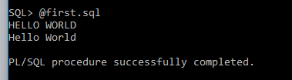
SQL> @first.sql
DECLARE
message varchar(20):='Hello World';
BEGIN
dbms_output.put_line('HELLO WORLD');
dbms_output.put_line(message);
END;
/

Slide 4
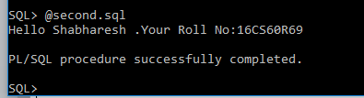
User Defined Sub Types
DECLARE
SUBTYPE string IS char(11);
SUBTYPE alphanumeric IS varchar2(100);
name string;
rollno alphanumeric;
BEGIN
name := 'Shabharesh ';
rollno := '16CS60R69';
dbms_output.put_line('Hello '||name||'.Your Roll No:'||rollno);
END;
/

Slide 5
Variables
variable_name [CONSTANT] datatype [NOT NULL] [:= | DEFAULT initial_value]
pi CONSTANT double precision := 3.1415;
name varchar2(25);
greetings varchar2(20) DEFAULT 'Have a Good Day';
DECLARE
-- Global Variables
BEGIN
--Local Variables
END;

Slide 6
Data
create table employee(ID int PRIMARY KEY, NAME VARCHAR(20) NOT NULL,AGE INT, SALARY DECIMAL(18,2));
insert into employee values('1','Saptarshi','25','123456.78');
insert into employee values('2','Sabarish','25','23456.78');
insert into employee values('3','Shreyans','26','1234567.789');
insert into employee values('4','Sabarish','25','12345678.90');

Slide 7

Retrieving a single record
DECLARE
e_id employee.ID%type := 1;
e_name employee.NAME%type;
e_age employee.AGE%type;
e_sal employee.SALARY%type;
BEGIN
SELECT NAME, AGE, SALARY INTO e_name, e_age, e_sal
FROM employee
WHERE ID = e_id;
dbms_output.put_line
('Employee ' ||e_name || ' having age ' || e_age || ' earns ' || e_sal);
END;
/

Slide 8
Conditions
IF <condition> THEN
<statements>
END IF;
IF <condition> THEN
<statements>
ELSIF <condition> THEN
<statements>
ELSE
<statements>
END IF;

Slide 9
Conditions (contd….)
CASE selector
WHEN 'value1' THEN S1;
WHEN 'value2' THEN S2;
WHEN 'value3' THEN S3;
...
ELSE Sn; // default case
END CASE;
CASE
WHEN selector =‘value1’ THEN S1;
WHEN selector=‘value2’ THEN S2;
WHEN selector =‘value3’ THEN S3;
...
ELSE Sn; // default case
END CASE;

Slide 10
Loops
LOOP
<statements>;
END LOOP;
“exit” is the keyword to break the loop
exit;
exit WHEN <condition>;
WHILE condition LOOP
<statements>
END LOOP;

Slide 11
Loops (contd..)
FOR counter IN initial_value .. final_value LOOP
<sequence_of_statements>;
END LOOP;
FOR counter IN REVERSE initial_value .. final_value LOOP
<sequence_of_statements>;
END LOOP;
CONTINUE;
Nested loops also possible
GOTO also supported …..

Slide 12
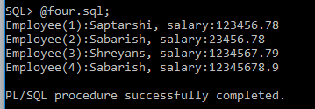
Retrieving multiple records
CREATE Or REPLACE TYPE nameofarray AS VARRAY(3) OF VARCHAR2(10);
DECLARE
CURSOR e_employee is SELECT NAME,SALARY FROM employee;
type e_list is varray (6) of employee.NAME%type;
type es_list is varray (6) of employee.SALARY%type;
name_list e_list := e_list();salary_list es_list :=es_list();
counter integer :=0;
BEGIN
FOR n IN e_employee LOOP
counter := counter + 1;name_list.extend; salary_list.extend;
name_list(counter) := n.name;salary_list(counter) := n.salary;
dbms_output.put_line('Employee('||counter ||'):'||name_list(counter)||', salary:'||salary_list(counter));
END LOOP;
END;
/

Slide 13
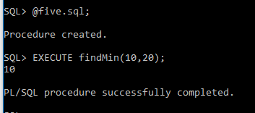
Procedure
CREATE OR REPLACE PROCEDURE
findMin(x IN number, y IN number) AS
BEGIN
IF x < y THEN
dbms_output.put_line(x);
ELSE
dbms_output.put_line(y);
END IF;
END;
/

Slide 14

Procedure
DECLARE
a number;b number;c number;
PROCEDURE findMin(x IN number, y IN number, z OUT number) IS
BEGIN
IF x < y THEN
z:= x;
ELSE
z:= y;
END IF;
END;
BEGIN
a:= 10;b:= 20;
findMin(a, b, c);
dbms_output.put_line(' Minimum of (10,20) : ' || c);
END;
/
We can declare a variable as IN and OUT both

Slide 15

Functions
DECLARE
total decimal;
FUNCTION totalsalary
RETURN decimal IS
total decimal:=0;
BEGIN
SELECT SUM(SALARY) into total FROM employee;
RETURN total;
END;
BEGIN
total := totalsalary();
dbms_output.put_line('Sum of Salaries:'||total);
END;
/

Slide 16
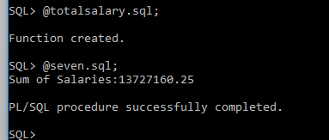
Functions
totalsalary.sql
CREATE OR REPLACE FUNCTION totalsalary
RETURN number IS
total decimal(18,2) := 0;
BEGIN
SELECT SUM(SALARY) into total FROM employee;
RETURN total;
END;
/
seven.sql
DECLARE
total decimal(18,2);
BEGIN
total := totalsalary();
dbms_output.put_line('Sum of Salaries:'||total);
END;
/

Slide 17
Triggers
Triggers are stored programs, which are automatically executed or fired when some events occur. Triggers are, in fact, written to be executed in response to any of the following events:
A database manipulation (DML) statement (DELETE, INSERT, or UPDATE).
A database definition (DDL) statement (CREATE, ALTER, or DROP).
A database operation (SERVERERROR, LOGON, LOGOFF, STARTUP, or SHUTDOWN).
Triggers can be defined on the table, view, schema, or database with which the event is associated.

Slide 18
Benefits
Generating some derived column values automatically
Enforcing referential integrity
Event logging and storing information on table access
Auditing
Synchronous replication of tables
Imposing security authorizations
Preventing invalid transactions

Slide 19
Basic Steps
alter session set "_ORACLE_SCRIPT"=true;
create user sabarish identified by sabarish;
grant all privileges to sabarish;
CREATE OR REPLACE TRIGGER display_salary_changes
BEFORE DELETE OR INSERT OR UPDATE ON employee
FOR EACH ROW
WHEN (NEW.ID > 0)
DECLARE
sal_diff number;
BEGIN
sal_diff := :NEW.salary - :OLD.salary;
dbms_output.put_line('Old salary: ' || :OLD.salary);
dbms_output.put_line('New salary: ' || :NEW.salary);
dbms_output.put_line('Salary difference: ' || sal_diff);
END;
/

Slide 20
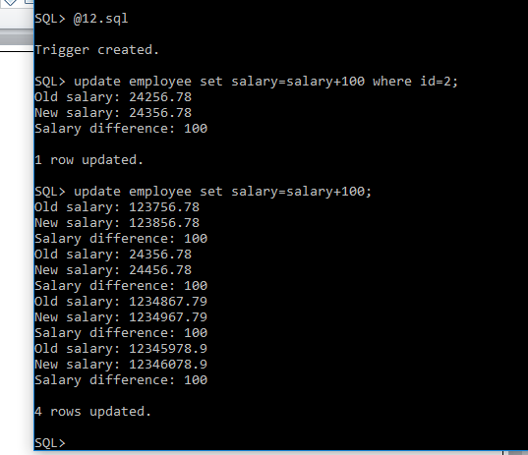

Slide 21
Transactions
SAVEPOINT < savepoint_name >;
ROLLBACK; // roll back all the changes
ROLLBACK <savepoint_name>;
COMMIT;
SET AUTOCOMMIT ON;
SET AUTOCOMMIT OFF;

